Slide 1

Network Address Translation (NAT) USING CISCO PACKET TRACER
Batch Members Supervisor
Navadeep Reddy(2010030313) Dr. P Lalitha Surya Kumari
Siddharth(2010030475) Professor
Vipul Reddy(2010030502)
Manoj Peravali(2010030503)

Slide 2
Abstract
Network Address Translation (NAT) is designed for IP address simplification and conservation. NAT is similar to Classless Inter‐Domain Routing (CIDR) in that the original intention for NAT was to slow the depletion of available IP address.
The names used to describe the addresses used with NAT are easy to remember. Addresses used after NAT translations are called global addresses.

Slide 3
Introduction
NAT is the process of reassigning the single IP address into a further one by altering the network address data in the IP header while they are traveling through a network towards the destination node.
NAT works on a router or gateway and interconnects two networks with each other by translating the private addresses before the data being transmitted to another network.
NAT is having the potential to broadcast only one IP address to the public network on behalf of the entire internal network. This provisions the feature of security by efficiently hiding the overall IP address of the private network behind that solo address.

Slide 4
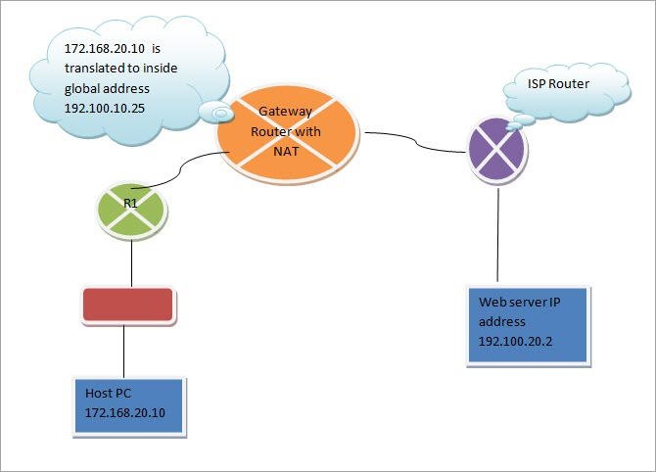
FLOW CHART

Slide 5
Literature Survey
S . NO | AUTHORS | TITLE | PUBLISHING | PROs | CONs
1 | G. Tsirtsis P. Srisuresh | Network Address Translation - Protocol Translation (NAT-PT) | Feb 2020 | Transparent route | No dual support Ipv4 and IPv6
2 | Lixia Zhang, University of California, Los Angele | A Retrospective View of Network Address Translation | September/October 2018 | - | -
3 | M. Bagnulo Sullivan P. Matthews | DNS Extensions for Network Address Translation from IPv6 Clients to IPv4 Servers | Apr 2018 | client server connection between IPv6 client and Ipv4 server | No connection can be established between IPv6 to IPv6(Advanced nodes like dual stack node can do that)

Slide 6
METHODOLOGY
NAT takes several forms: i) Static NAT (SNAT) ii) Dynamic NAT (DNAT) iii) Port Address Translation (PAT)
STATIC NAT:
When using SNAT, a single internal (private) address is mapped to a single external (public) address. This type of implementation is most commonly used when a device inside a privately addressed network must be accessible directly from the Internet

Slide 7
METHODOLOGY
DYNAMIC NAT:
DNAT provides the functionality of SNAT, but with a pool of addresses that are not device-specific.
PORT ADDRESS TRANSLATION:
PAT offers a method that can be configured statically or dynamically, but in either case it provides a solution to the address exhaustion problem, by allowing multiple devices to use the same external IP address at the same time. This technique works primarily by taking advantage of Layer 4 TCP and UDP port numbers. The source port number is altered and mapped for each outgoing connection; in this way, any returning traffic to that specific port can be mapped to the correct internal address

Slide 8
Software and Hardware Requirements
SOFTWARE REQUIREMENTS: -
Operating system - Windows 10
Tools – CISCO PACKET TRACER
HARDWARE REQUIREMENTS: -
RAM - 8.00 GB (7.87 GB usable)
Processor - Intel(R) Core (TM) i5-10300H CPU @ 2.50GHz 2.50 GHz
System-type - 64-bit operating system, x64-based processor
Version - 20H2
Edition - Windows 10 Home Single Language

Slide 9
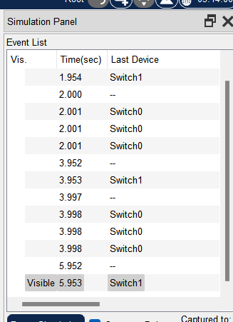
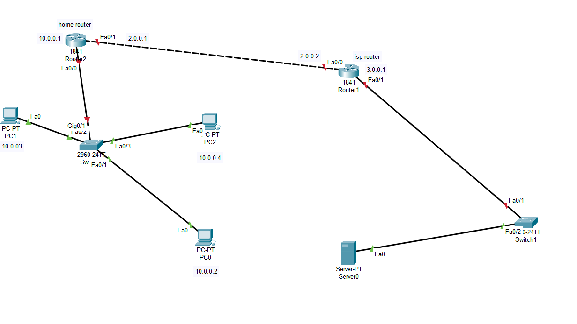
Results

Slide 10
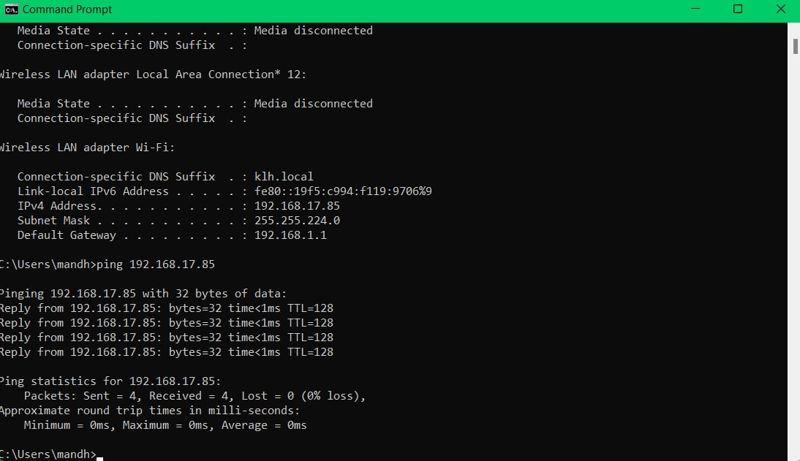
Results
OUTPUT SCREEN:

Slide 11
Github Setup

Slide 12
Conclusion
Network address translation, when used appropriately, is a valuable resource to managed service providers. It can be used to direct traffic as needed and helps to conserve IP addresses in the public space. While there are different types of network address translation based on need, there are tools to use and security considerations to be made for each case. Now that we’ve made network address translation easier to understand, this is a great time to do a little research to see how it can be better used to help your managed service provider and its clients today.

Slide 13
Future Scope
Network plays a major role in communication between the various devices, we tried to develop a basic network which is easy to understand and can be applied to any kind of usage.
The following are major changes we are trying to bring in our project:
Expanded Network capabilities
Associated GUI for easier accessibility
Addition of additional features to enhance the communication
Increase security.

Slide 14
References
Xu, L.; Wang, X.; Shen, J. Strategy and simulation of trust cluster based key management protocol for adhoc networks. In Proceedings of the 2009 4th International Conference on Computer Science & Education,Nanning, China, 25–28 July, 2009; pp. 269–274.
Kwo, P.Y.; Lawitz, E.J.; McCone, J.; Schiff, E.R.; Vierling, J.M.; Pound, D.; Davis, M.N.; Galati, J.S.;Gordon, S.C.; Ravendhran, N.; et al. Efﬁcacy of boceprevir, an NS3 protease inhibitor, in combinationwith peginterferon alfa-2b and ribavirin in treatment-naive patients with genotype 1 hepatitis C infection(SPRINT-1): An open-label, randomised, multicentre phase 2 trial. Lancet 2010,376, 705–716.
Rahman, M.U.; Rehman, A.U.; Liu, H.; Chen, H.F. Inhibitory mechanism of 5-bromo-3-indoleacetic acid fornon-structural-3 helicase hepatitis C virus with dynamics correlation network analysis. Comput. Biol. Chem.2018,77, 167–177
Akilli, G. K. (2007). Games and simulations: A new approach in education? In D. Gibson, C. Aldrich, & M. Prensky,(Eds.), Games and simulations in online learning: Research and development frameworks (pp. 1–20).

